Slide 1
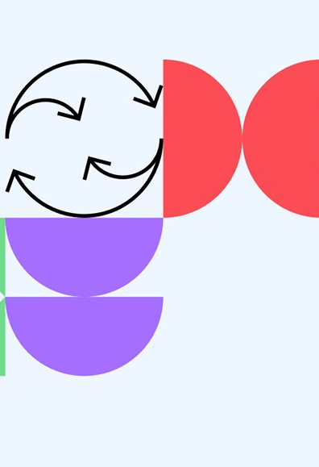
Kochi AI User group
Group Introduction and Discussion on RAG for domain specific conversation

Slide 2
Understanding Large Language Models (LLM’s)
An Overview of Their Capabilities and Applications
Presenters: KRISHNAMURTHY ARTHANARISAMY
BENJAMIN NECHICATTU
ASFAB K

Slide 3

Take aways
Basic understanding of LLMs
How to use LLMs for chat / QA
Implement RAG based chat application

Slide 4
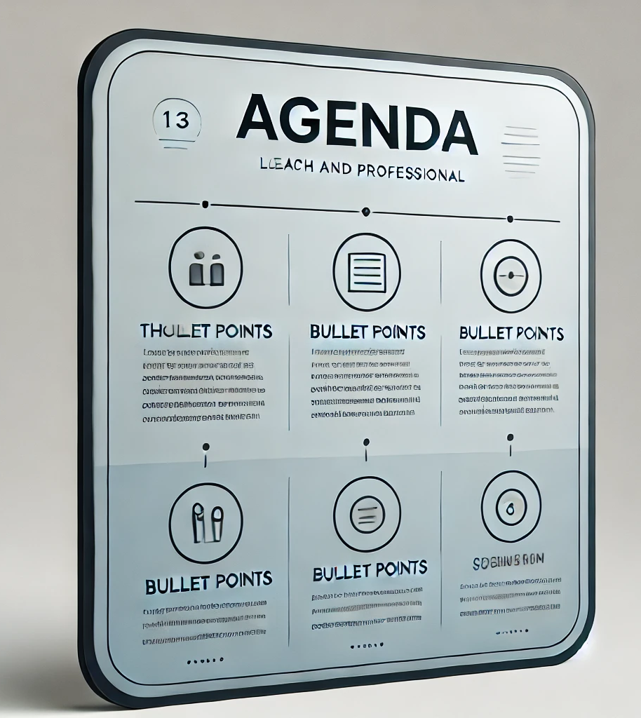
LLM Basics
Text Generation tuneableS
Introduction to RAG
Building a chat application for a domain specific Question and Answers

Slide 5
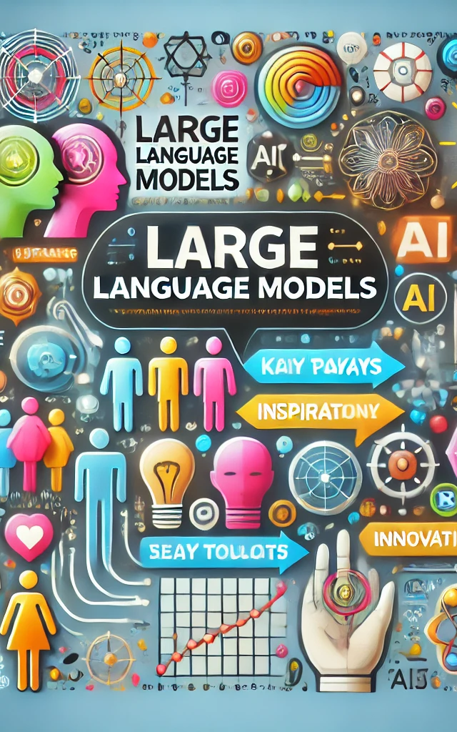
What are LLM’s?
Advanced AI systems for understanding and generating human language
Built using deep learning techniques and neural networks
Examples of tasks: Translation, Summarization , Question Answering, Text Generation

Slide 6
PURPOSE BUILT LLM’s
Natural Language Understanding and Generation
Code Generation
Question Answering and Information Retrieval
Translation and Multilingual Support
Summarization
Speech Recognition and Generation
Image Recognition and Classification
Speech Synthesis

Slide 7
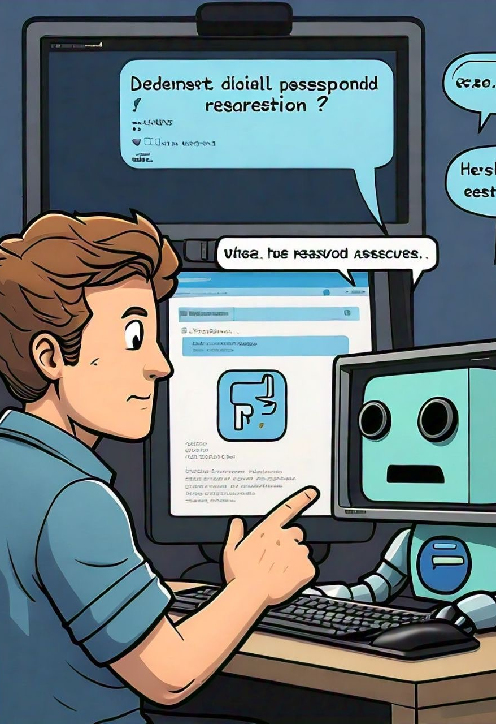
How to Interact with LLM
APIs for developers / Library’s Inputs
prompt
model
parameters – max token, temperature, etc.

Slide 8
Prompt Engineering
Crafting structured inputs to guide the behaviour of LLMs.
Optimizes the model's response to achieve specific outcomes.
Directly influences the performance and utility of LLM-generated responses.
Essential for tasks where precise or nuanced output is required.
Techniques
Zero-shot Learning
Few-shot Learning
Chain of Thought Prompting Prompt includes
Instructions / system prompts
Conversation history
User’s latest query

Slide 9

System Prompts
Setting tone, style, and function
Tone calibration
Behavioral guidelines Example: Customer support bot emphasizing politeness and clarity

Slide 10
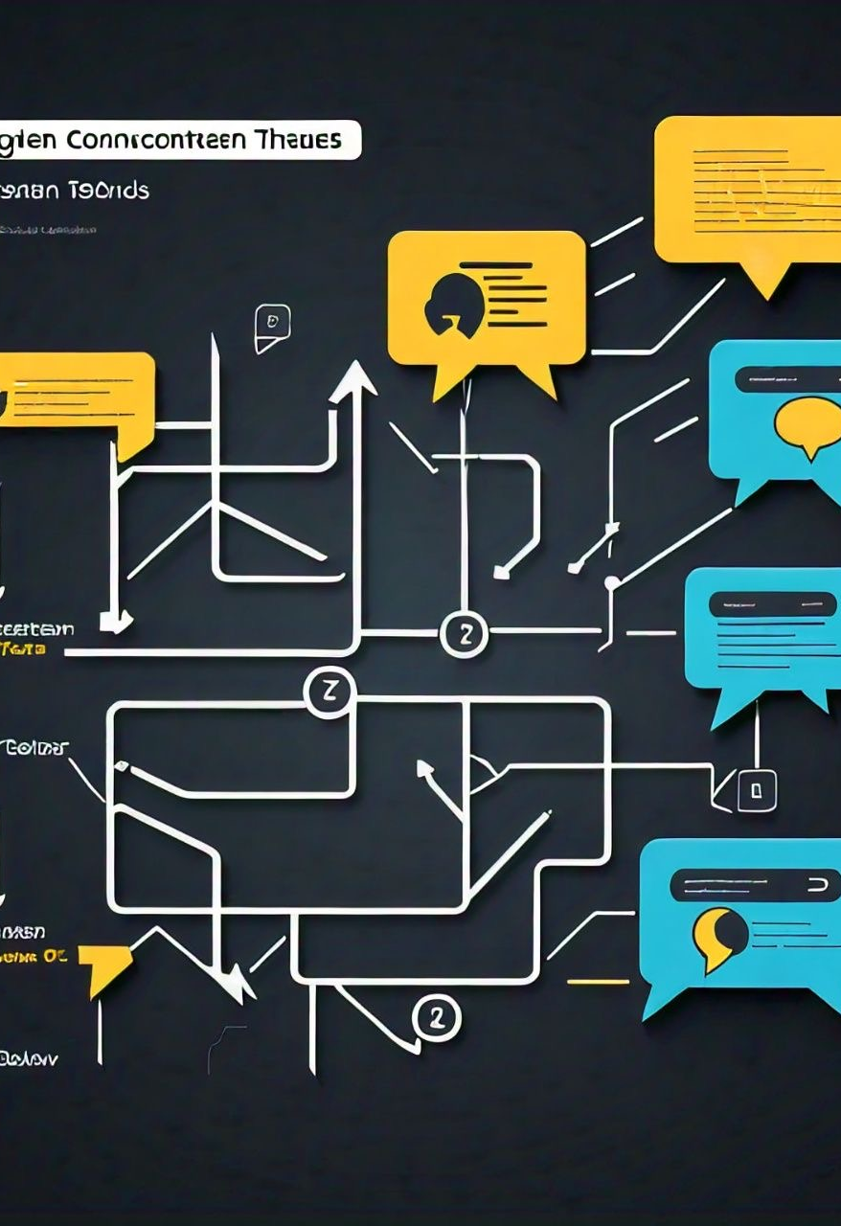
Chat Context
Critical for coherent conversations
Context window
State management
Session storage Ensures model refers back to previous parts of conversation for relevant responses

Slide 11
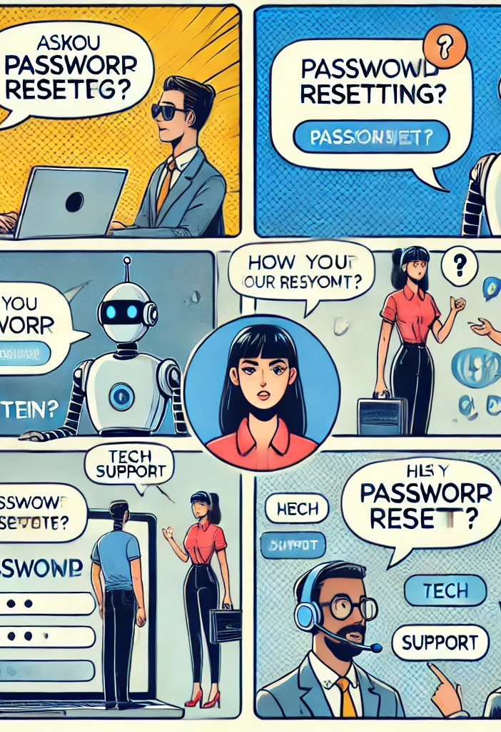
HANDLING Users’ PROMPT
Technically addressing users’ utterance involves
Natural Language Understanding (NLU)
Contextual Relevance
Dynamic response generation

